Slide 1
Thermoelectrics
A Project aimed at maximising the coefficient of performance zt.
By Andrew morris

Slide 2
Contents
What is the thermoelectric effect?
Thermoelectric generators
Introducing ZT
Why Semi-conductors?
Ranking Potential Thermoelectrics
The Kinetic Method

Slide 3
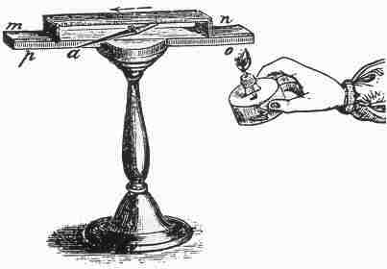
What is the thermoelectric effect?
The thermoelectric is the direct conversion of a temperature gradient into a potential difference or vice versa.
Categorised using three fundamental phenomena; The Seebeck effect, The Peltier effect and Joule heating (not covered in this presentation).
Image Source; http://www.thermoelectrics.caltech.edu/thermoelectrics/history.html

Slide 4


The Seebeck Effect
$$T_{c}$$
$$T_{h}$$
Diffusion
Electric Field
S is the Seebeck Coefficient (S) defined as the voltage generated per unit temperature difference.

Slide 5
The Peltier Effect
Material 1
Material 2
Charge carriers carry different thermal energies in different materials (the materials Peltier Coefficient)
When a current is applied across the interface heat must either be supplied or absorbed to accommodate this difference.

Slide 6
Why is the thermoelectric effect important?
Can be applied to either electric refrigerators or heat pumps.
Solid state devices mean long life times.
Has the potential to improve efficiency of existing devices through waste heat conversion.
Samples are expensive and time consuming to fabricate so theory becomes very important.

Slide 7
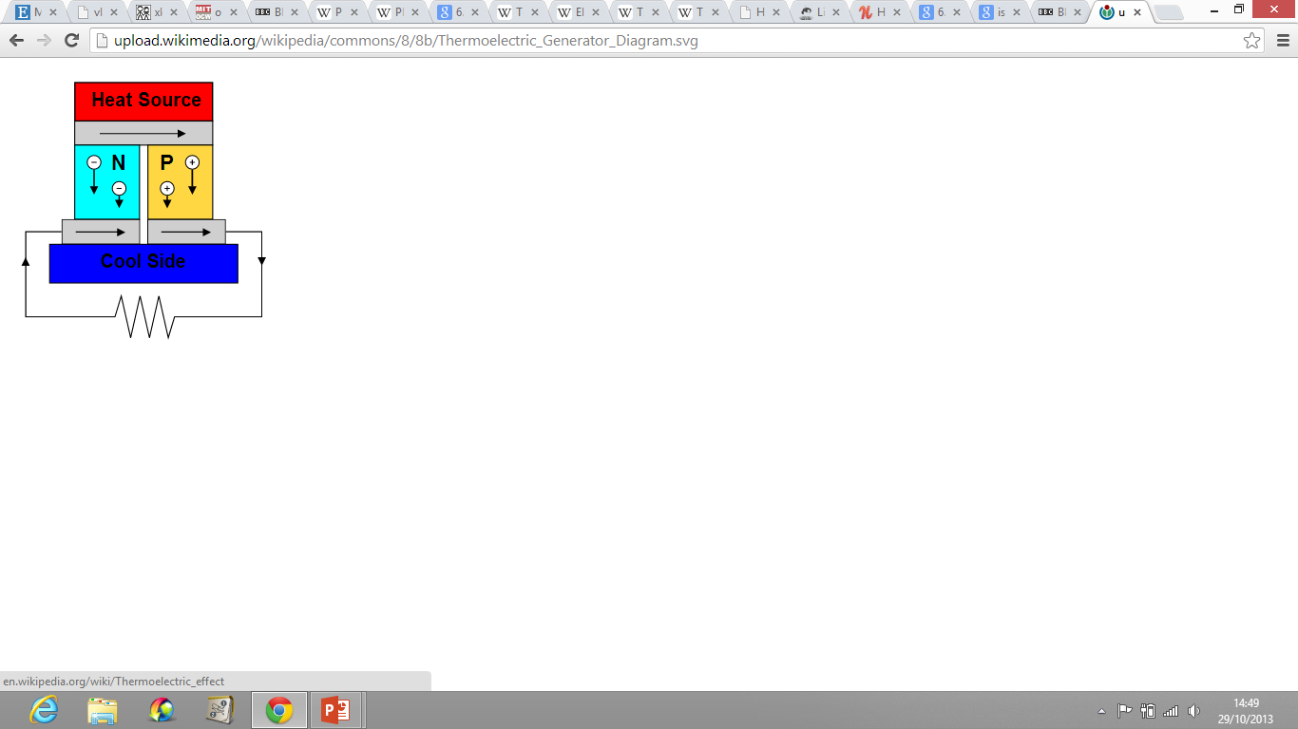
Thermocouples, A thermoelectric generator
P and N doped semiconductors connected in series amplify this effect.
http://upload.wikimedia.org/wikipedia/commons/8/8b/Thermoelectric_Generator_Diagram.svg

Slide 8
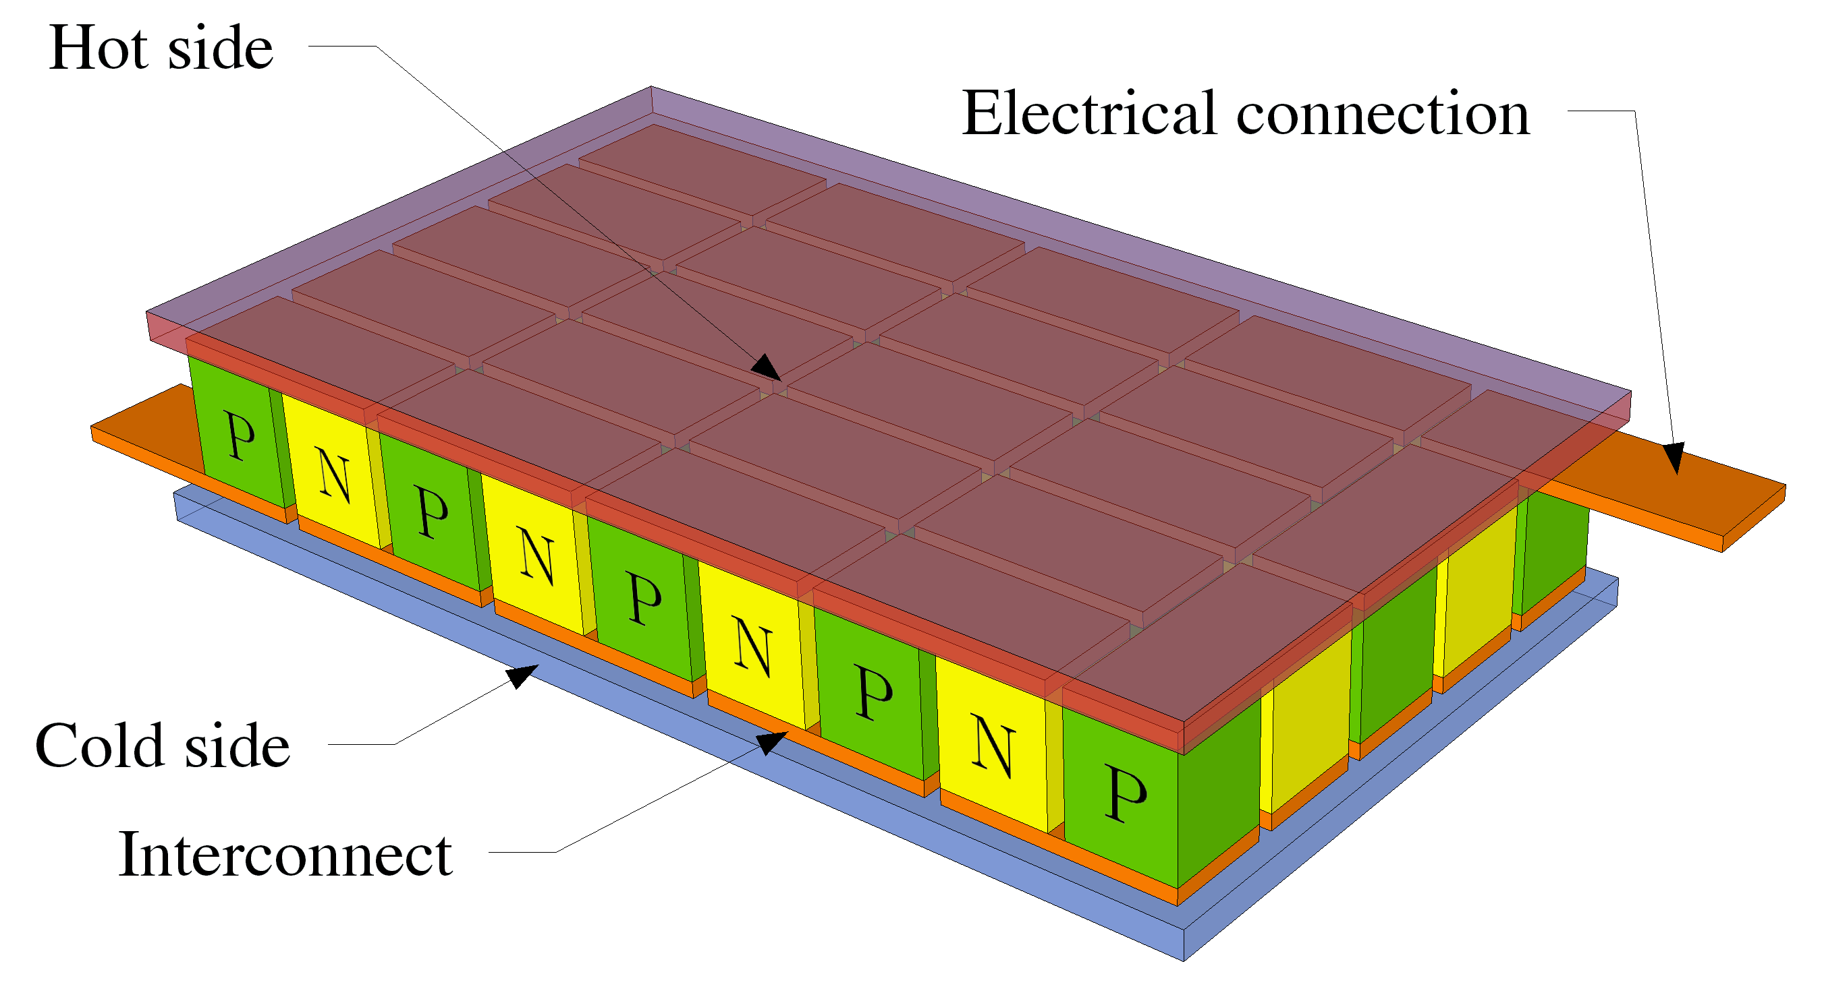
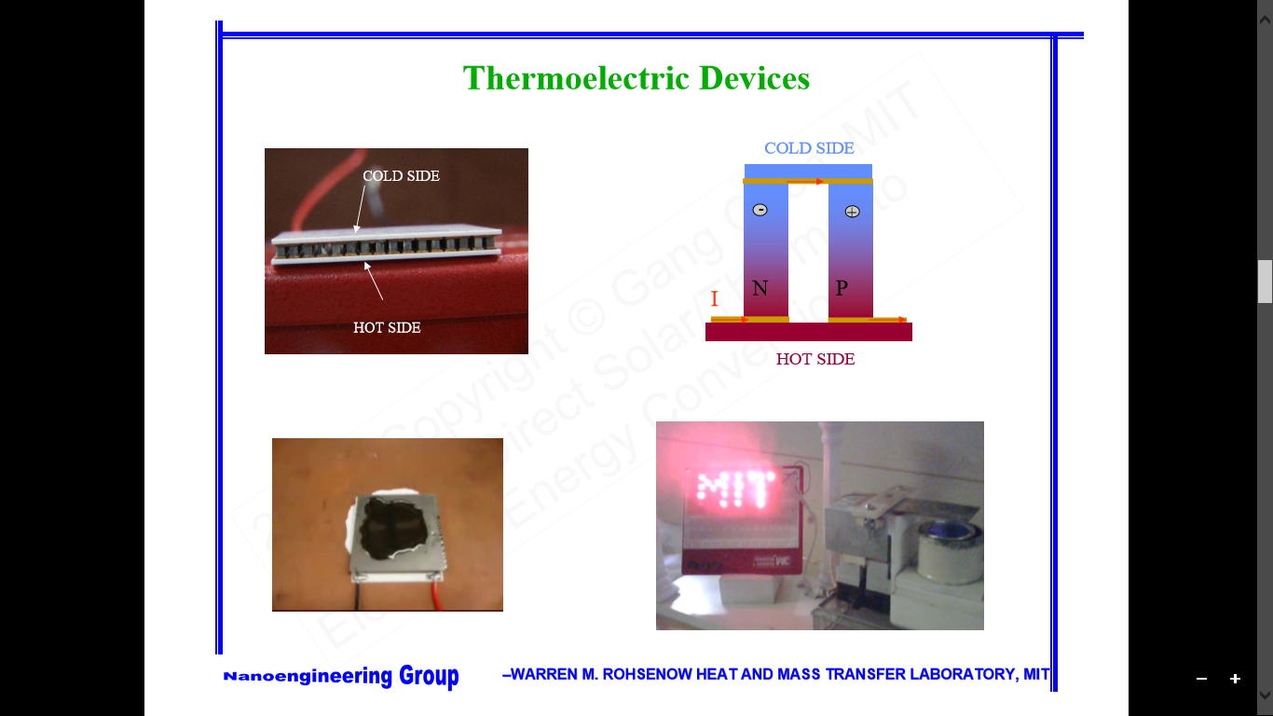
http://upload.wikimedia.org/wikipedia/commons/a/a2/Peltierelement.png
http://ocw.mit.edu/courses/mechanical-engineering/2-997-direct-solar-thermal-to-electrical-energy-conversion-technologies-fall-2009/audio-lectures/MIT2_997F09_lec02.pdf

Slide 9
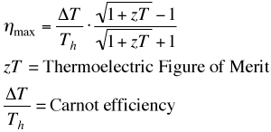

Introducing ZT; $zT=\frac{s^{2}σT}{k}$
zT drops out of the derivation of the efficiency of a thermoelectric generator.
To maximize efficiency we must aim to maximize zT.
For commercial applications zT=3 is the aim. At or past this point thermoelectrics would out perform existing energy harvesting technologies.
http://www.its.caltech.edu/~jsnyder/thermoelectrics/

Slide 10


The Seebeck Coefficient
Electrical Conductivity
$$zT=\frac{s^{2}σT}{k}$$
T is the absolute or mean temperature.
$$k=k_{cc}+k_{ph}+k_{bp}$$

Slide 11


Weidemann-Franz Law;
$k_{ph}$ is largely independent of other variables.
$$\frac{k_{cc}}{σ}=LT$$

Slide 12
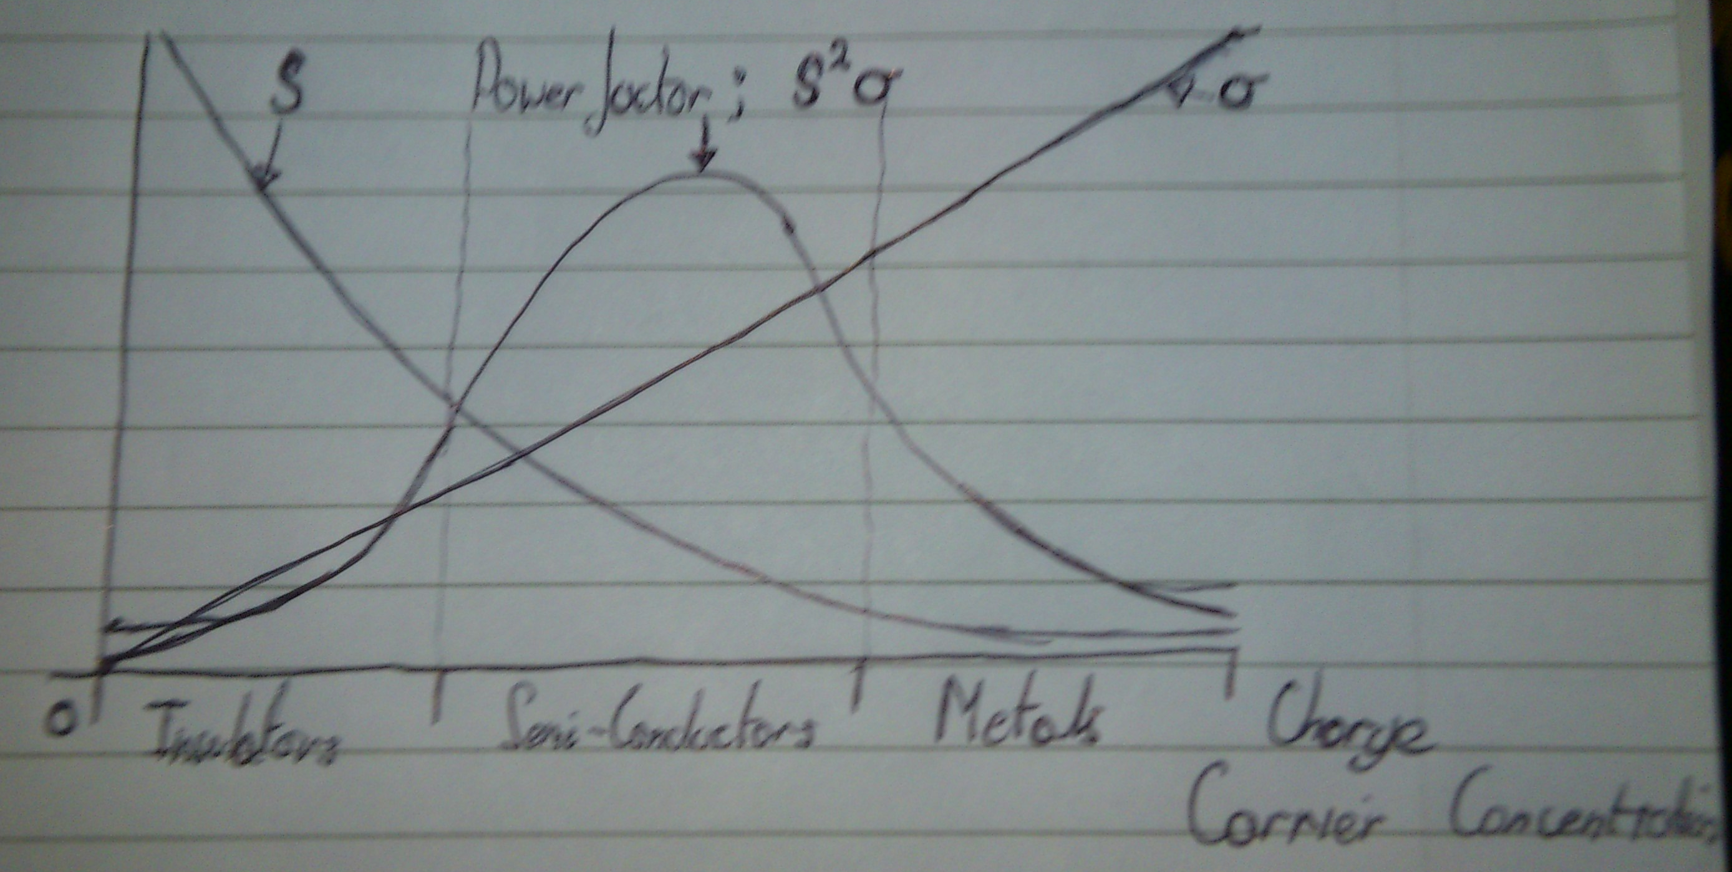
Why Semiconductors?

Slide 13
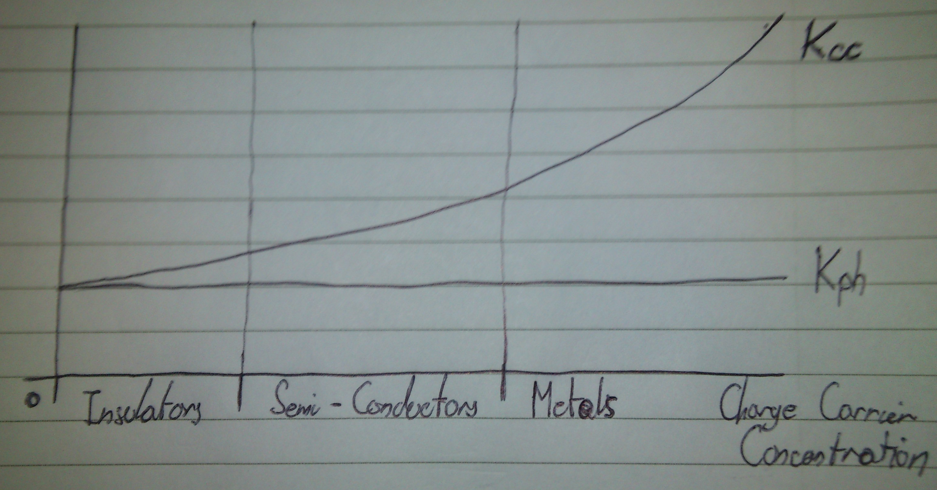

Slide 14
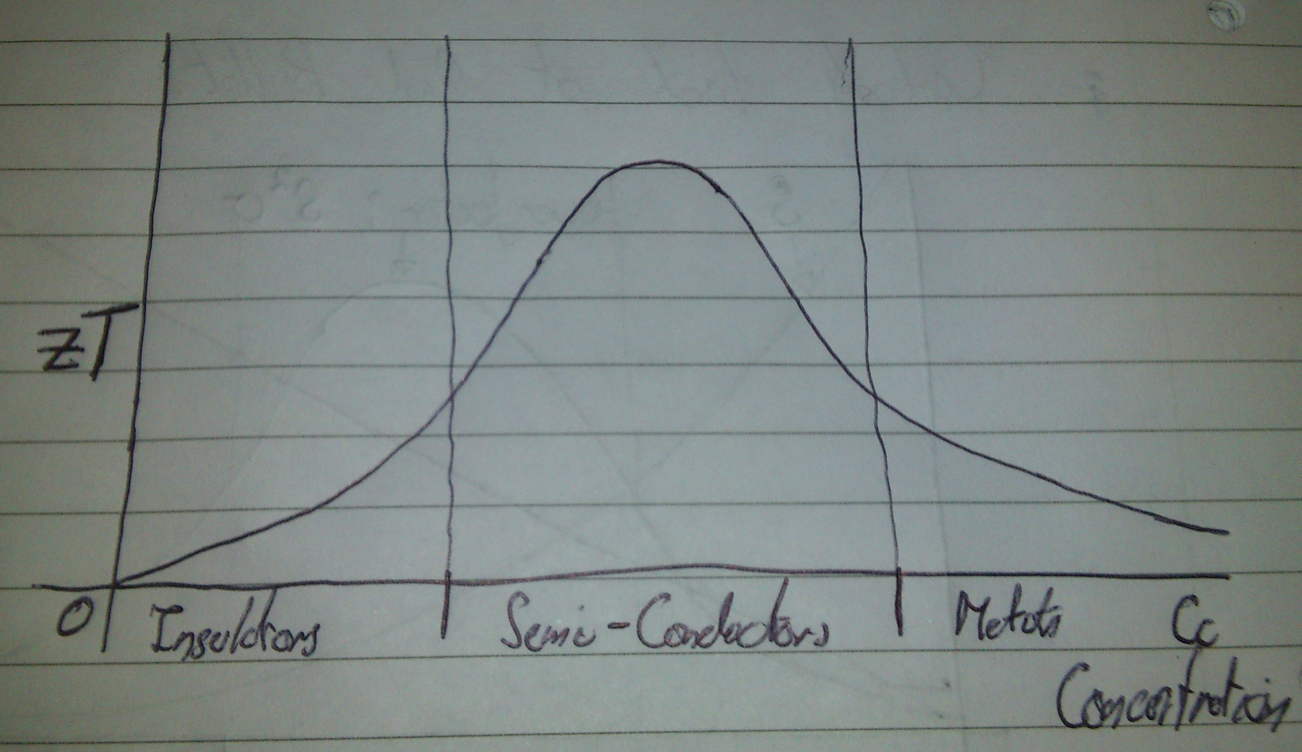

Slide 15
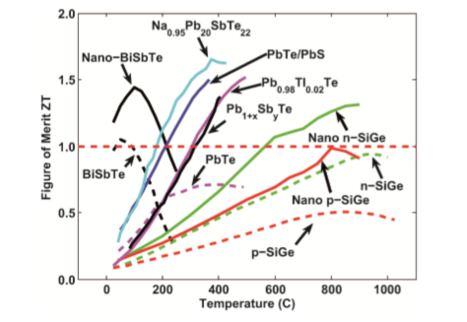
Ranking potential Thermoelectrics
Bulk nanostructured thermoelectric materials: current research and future prospects.
Authors; J. Minnich, M. S. Dresselhaus, Z. F. Ren and G. Chen

Slide 16
Material | Temperature Regime (k)
BiSbTe | 0-200 (Low)
PbTe | 200-500 (Interim)
SiGe | 500-1000 (High)
Larger range of efficient operation in SiGe.
Larger ZT in nano composites when compared to ‘traditional’ alloys.
N type SiGe shows higher ZT than P type SiGe.

Slide 17


The Kinetic Method
Assume electrons and phonons can be treated as classical non interacting particles.
Introduce a finite lifetime (Relaxation time) for electrons and phonons.
Drift Velocity can be derived as an example;
This idea can be expanded to derive the electrical conductivity;
$$\underset{→}{J}=n q \underset{→}{V}= σ \underset{→}{E}= \frac{n q^{2} τ}{m} \underset{→}{E}$$
$$\underset{→}{V}=\frac{q \underset{→}{E} τ }{m}$$

Slide 18
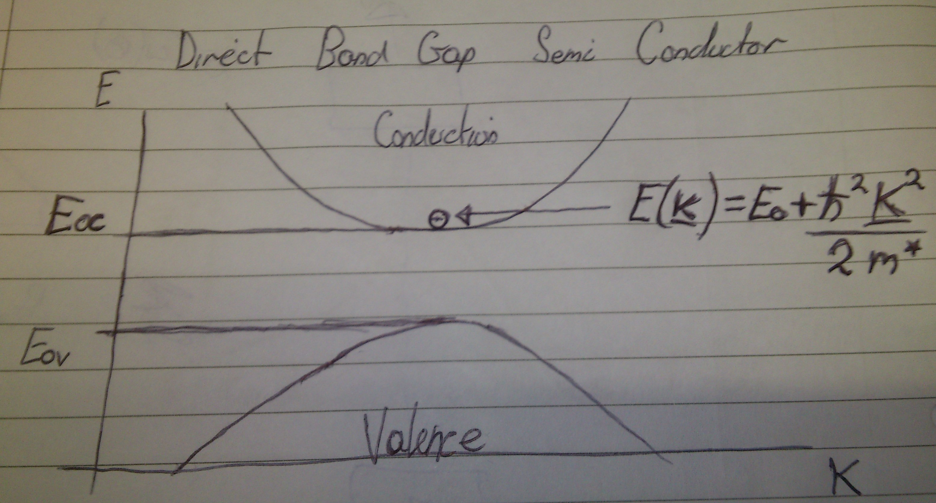
Electrons obey the Fermi-dirac distribution.
Modified by the Boltzmann transport equation (Due to the system not being in equilibrium).
A nearly free electron sitting in a potential can be approximated using the concept of effective mass.

Slide 19
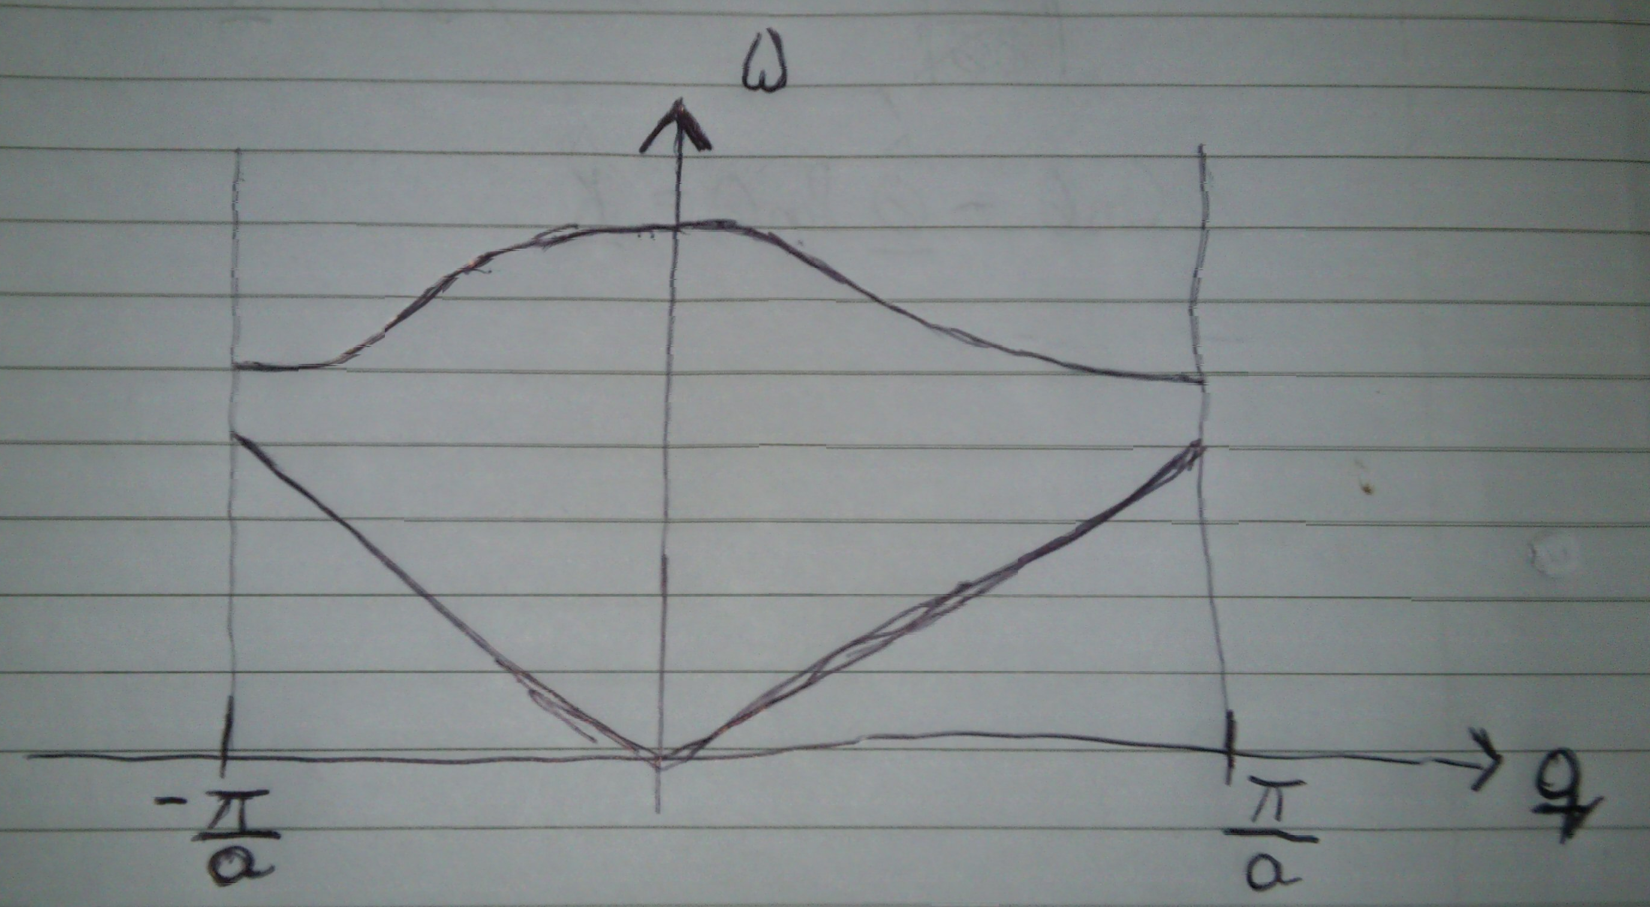

Phonons obey the Boze-Einstein Distribution.
$$n_{i}= \frac{g_{i}}{е^{\frac{ε_{i}− μ}{kT}}−1}$$
Modified by the Boltzmann transport equation (For phonons).

Slide 20

Phonon Glass Electron Crystal (PGEC)
Average phonon wavelength < Average charge carrier Wavelength
Disordered on the scale of phonons. Reducing phonon relaxation time due to more points of interference. Decreasing $k_{ph}$.
Ordered on the scale of charge carriers. Increasing charge carrier relaxation time. Improving our power factor.
This concept of PGEC will be key to increasing zT and will be the focus of our project.

